Slide 1
Graphs 1

Slide 2
Today
What is a graph
Lots of examples
How are graphs relevant for our project
A data structure called queues
This lecture will give us the fundamentals we need to understand and build algorithms to route our drones

Slide 3
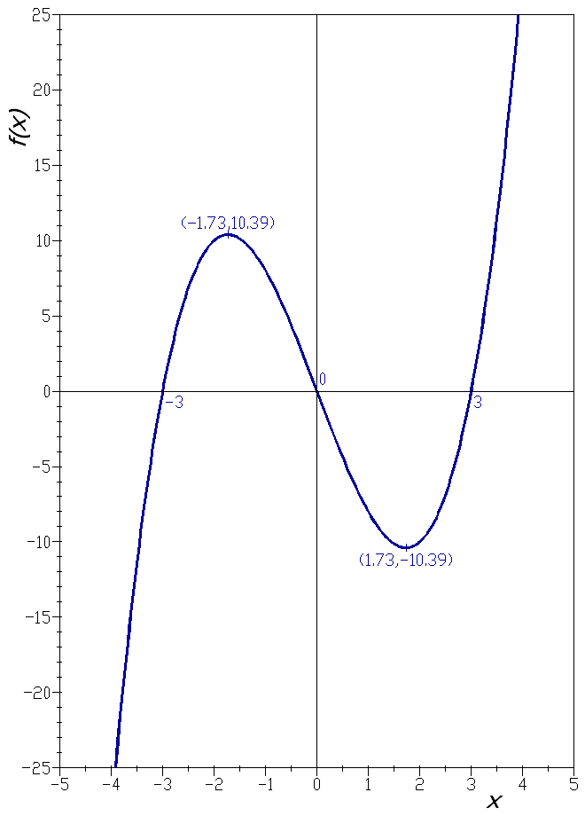
This kind?

Slide 4
This kind?
...let’s call that a plot!

Slide 5
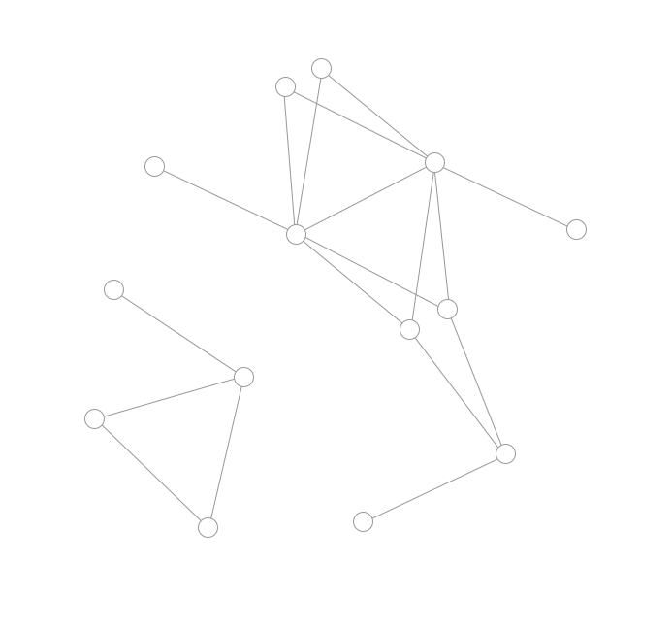
This kind?

Slide 6
This kind?
Yes!

Slide 7
This kind?
Yes!
Nodes

Slide 8
This kind?
Yes!
Edges
Nodes

Slide 9
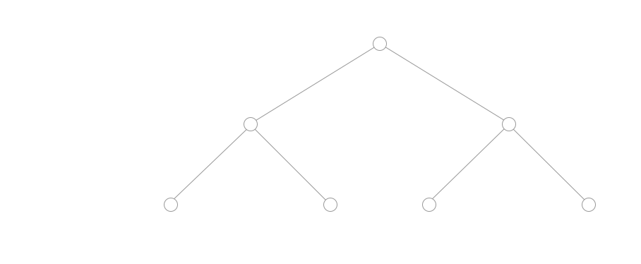
And this

Slide 10

And this

Slide 11
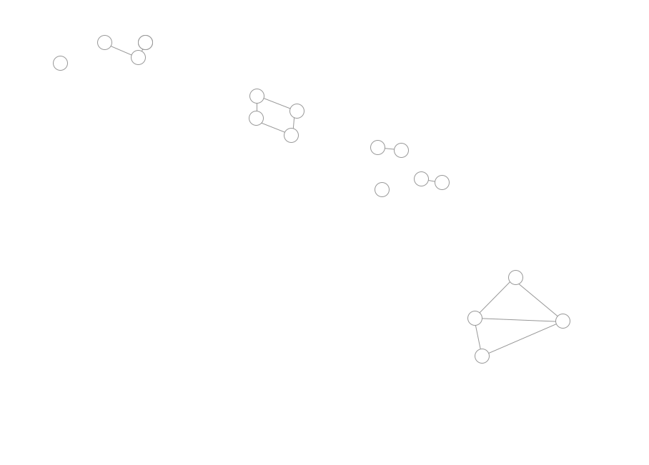
And this

Slide 12
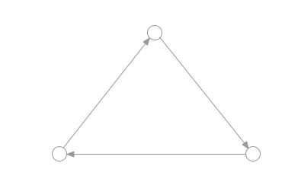
And this

Slide 13
So what is a graph abstractly?
A set of nodes (e.g., cities)
A set of edges between nodes (e.g., highways)

Slide 14
What were those graphs we saw?

Slide 15
Example 1:

Slide 16
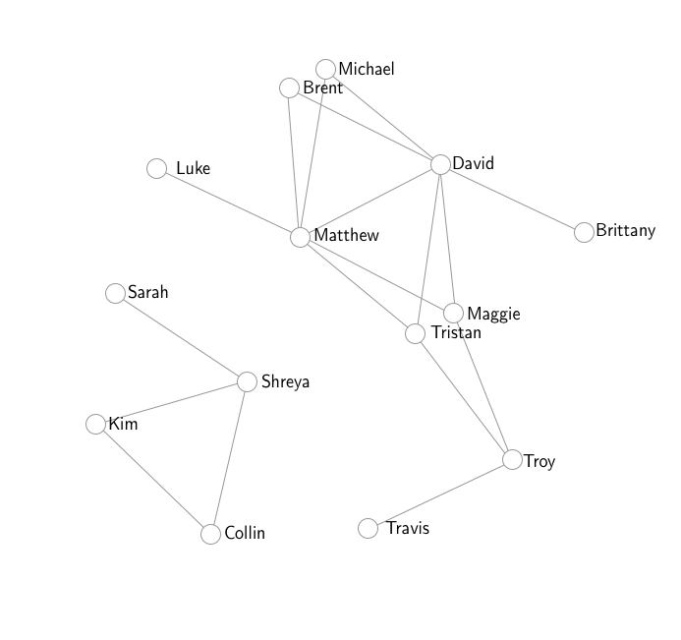
Example 1:

Slide 17
Example 2:

Slide 18
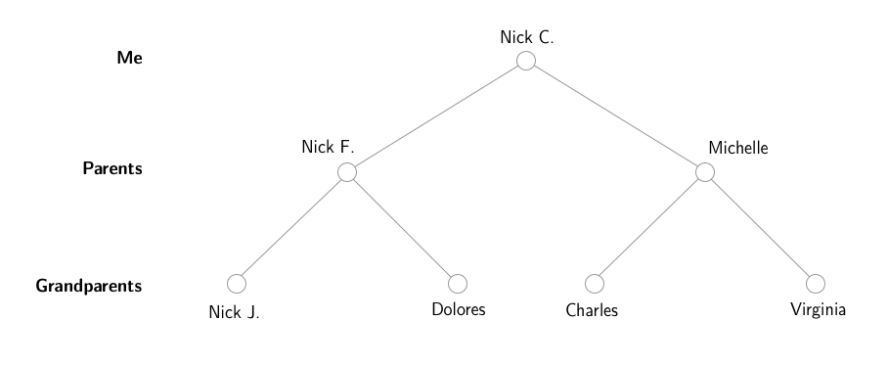
Example 2:

Slide 19
Example 3:

Slide 20
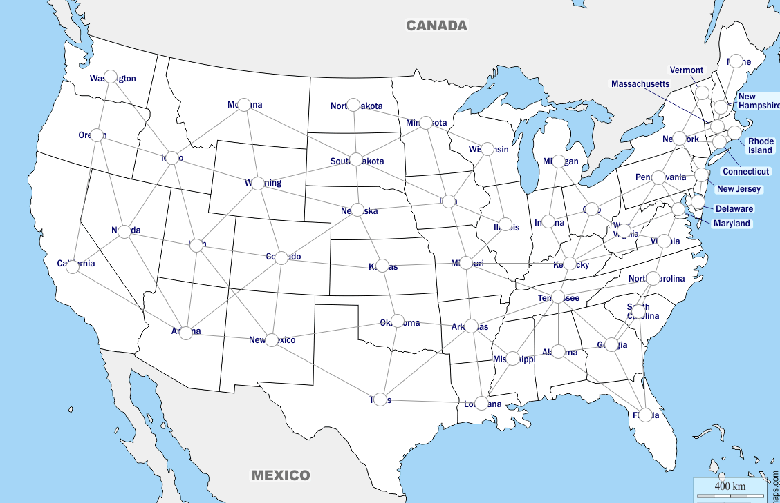
Example 3:

Slide 21
Example 4:

Slide 22
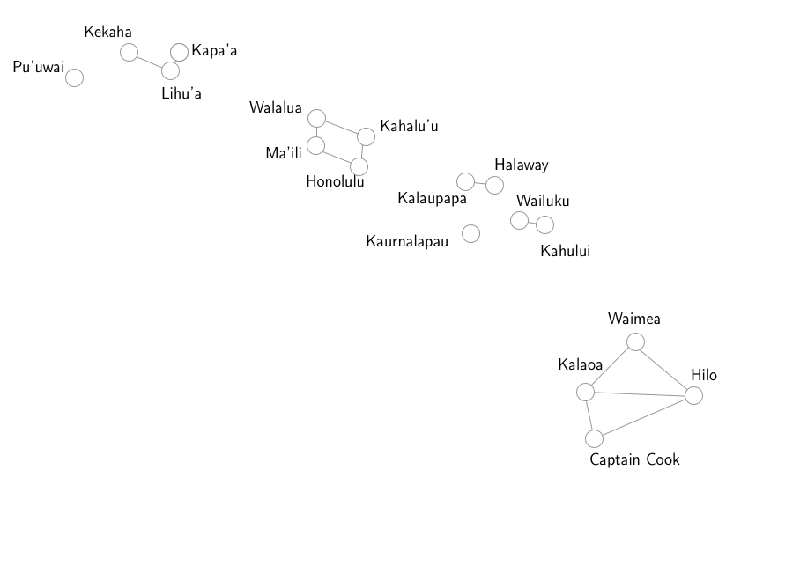
Example 4:

Slide 23
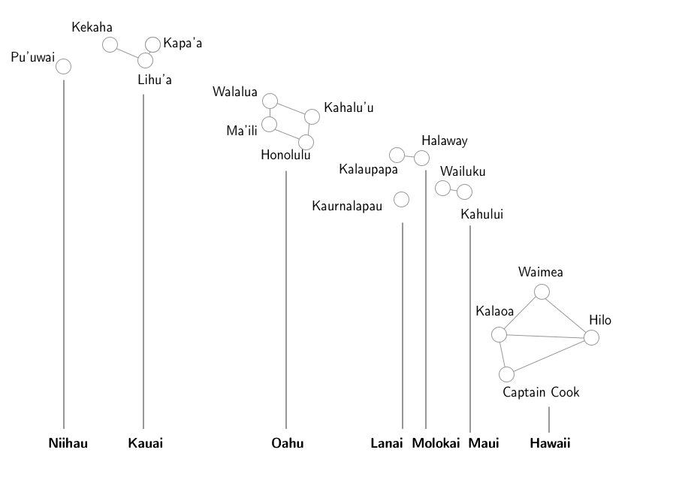
Example 4:

Slide 24
Example 5:

Slide 25
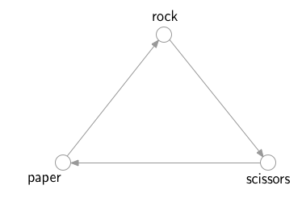
Example 5:

Slide 26
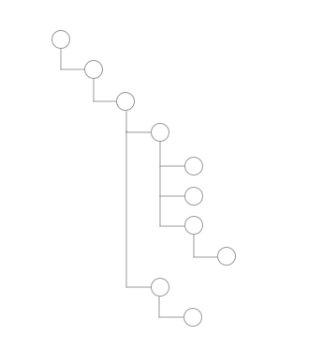
Example 6:

Slide 27

Example 6:

Slide 28
Other examples?

Slide 29
Other examples?
Internet: documents are nodes, edges are links
Air Travel: nodes are airports, edges are connecting flights
Road network: nodes are intersections, edges are roads
Subway system: nodes are stops, edges are tracks
Trail map: nodes are campsites, edges are trails

Slide 30
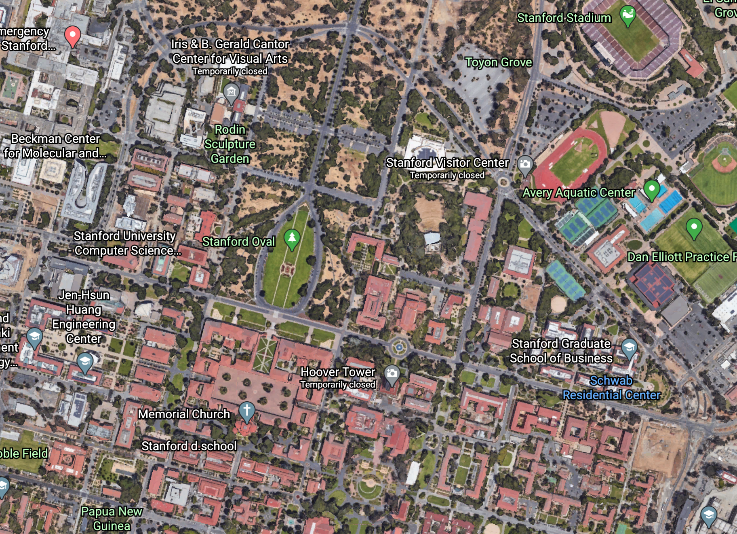
We will use graphs to do planning

Slide 31
We will slice up space...

Slide 32
...into a grid

Slide 33
Flyable squares...nodes

Slide 34
Fly between nodes...edges

Slide 35
Let’s think about this as a maze...

Slide 36
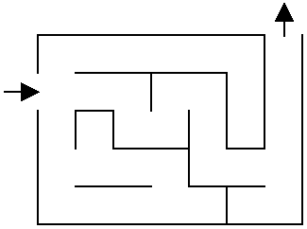

Slide 38
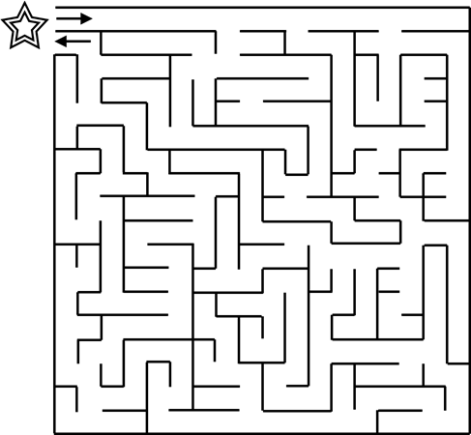

Slide 40
AI and Pathfinding
Artificial Intelligence: A branch of computer science that allows computers to make predictions and decisions
One example of AI: A system that can automatically solve a “pathfinding” task

Slide 41
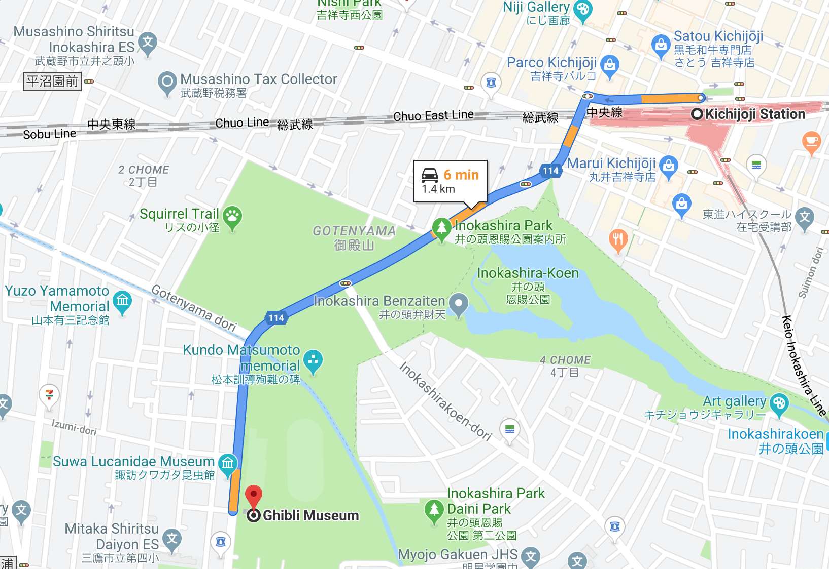
AI and Pathfinding
Artificial Intelligence: A branch of computer science that allows computers to make predictions and decisions
One example of AI: A system that can automatically solve a “pathfinding” task
Question of the day:
If we give a new map to our AI, how can we teach it to find the shortest path between point A and point B?

Slide 42
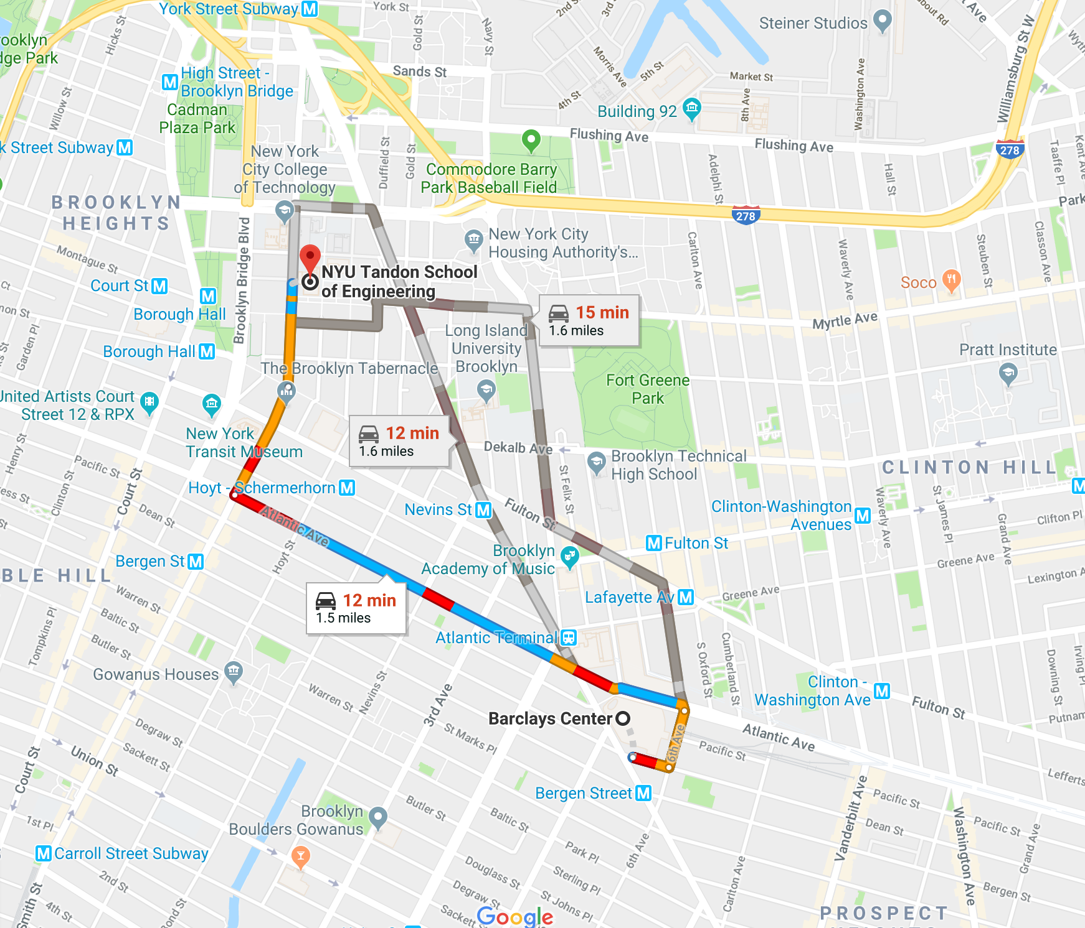
Different Pathfinding Tasks
In addition to the shortest path, here are some other paths we might want to find:
Path out of a maze
Path that goes through a set of cities exactly once
Path between two points that tries to avoid other people or robots (aka “agents”)
What path might we want for our autonomous flying vehicle?

Slide 43
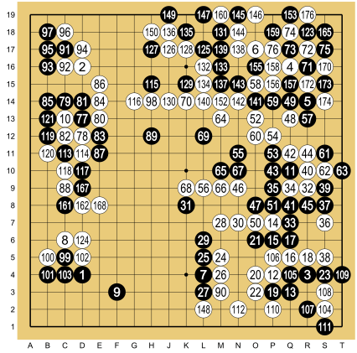
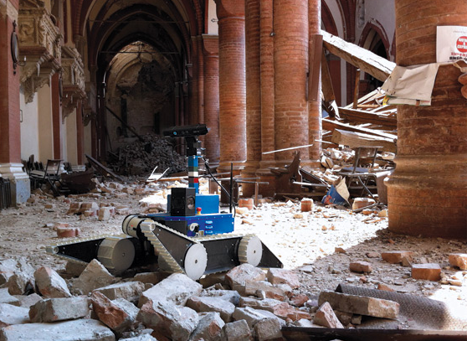
Search Applications
Search for the best next move to make in a game (like chess, checkers, Go, or even Starcraft)
Quickly find your student information out of a database of thousands of students
Help robots deliver medication and food to the correct rooms in a hospital
Help robots search through a disaster site to find people who may need to be rescued

Slide 44
FROM MAPS TO GRAPHS

Slide 45
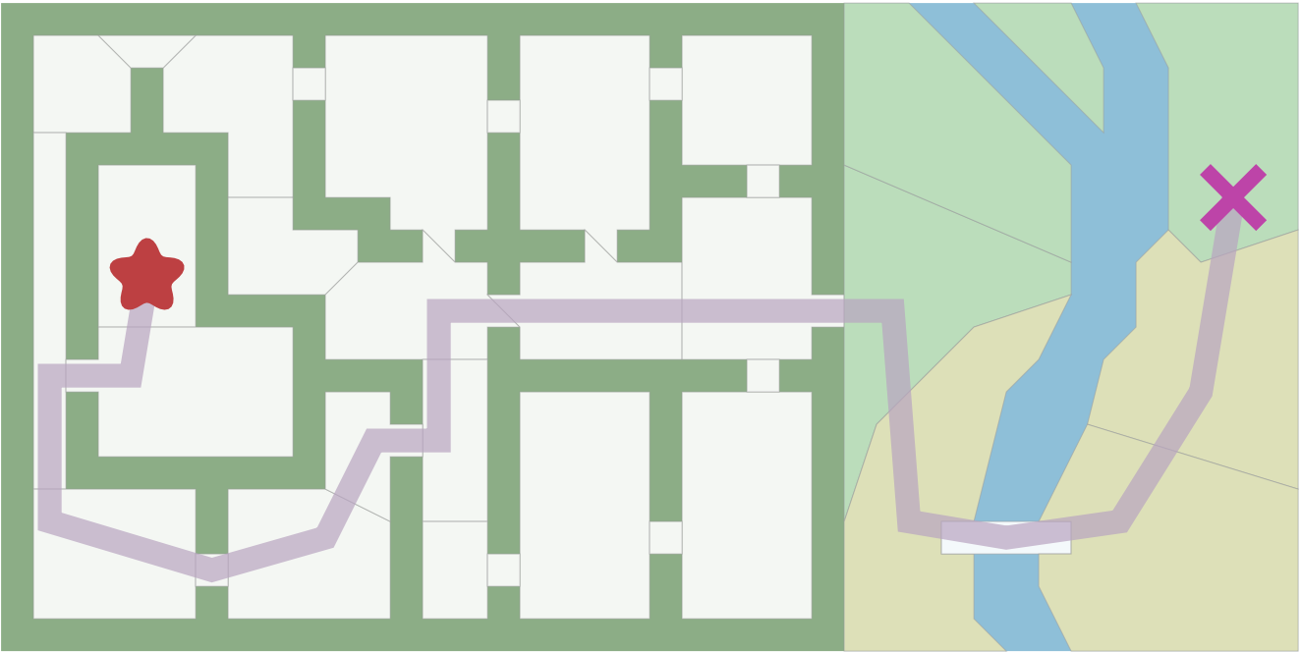
How can we tell our computers what decisions it can make when travelling through a map?

Slide 46
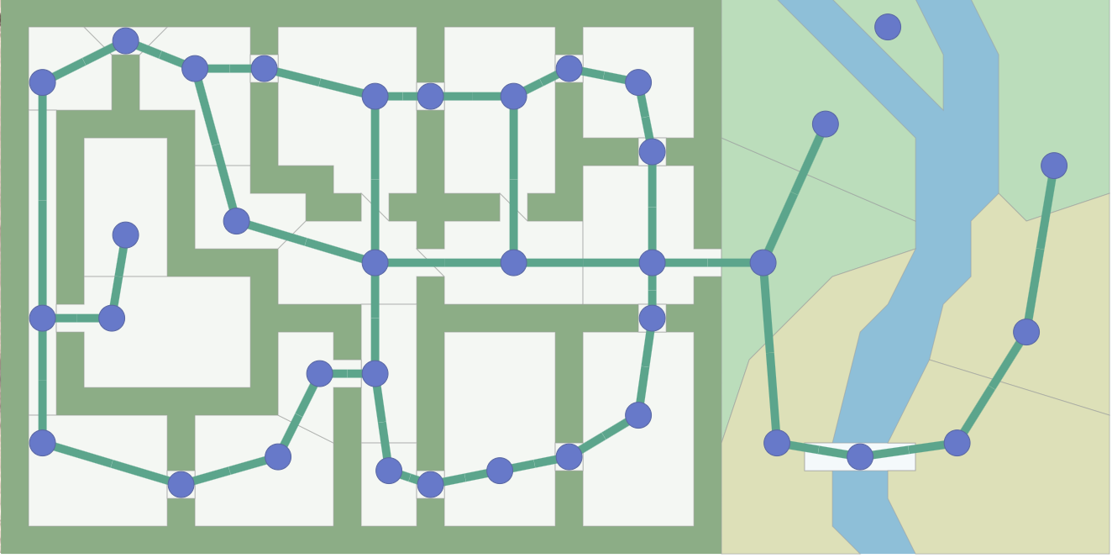
Answer: We represent the map using a graph

Slide 47
Answer: We represent the map using a graph*
* Not the same as the “x-y graph” you learned about in algebra

Slide 48
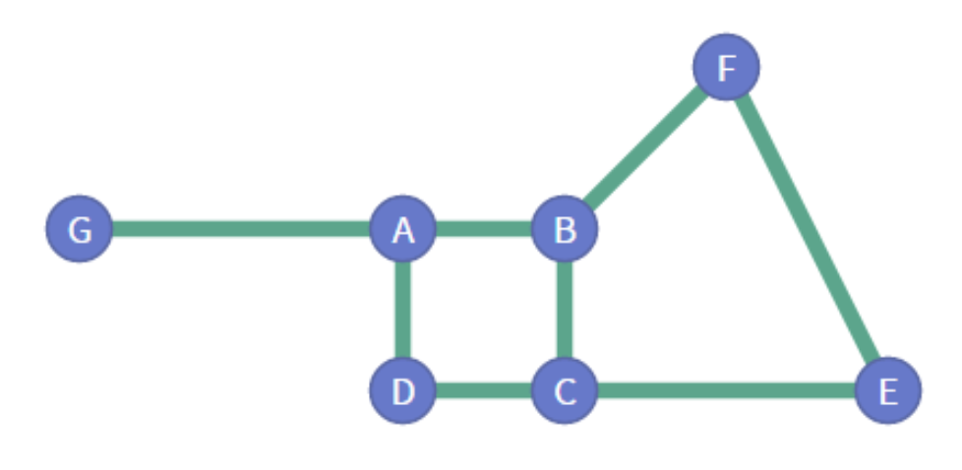
Parts of a Graph
Node (or vertex)
Edge

Slide 49
Parts of a Graph
Node (or vertex)
Edge
How many nodes are there?
How many edges?

Slide 50
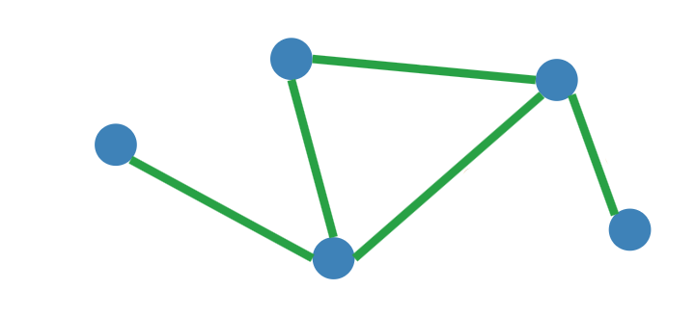
Types of Graphs
Undirected
Directed
Unweighted
Weighted

Slide 51
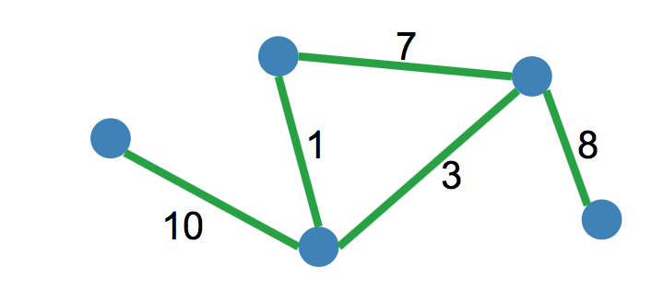
Types of Graphs
Undirected
Directed
Unweighted
Weighted

Slide 52
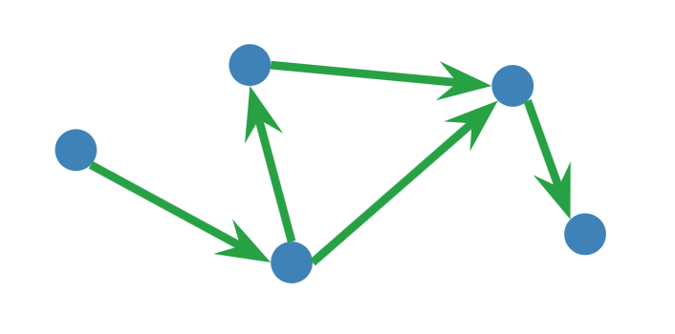
Types of Graphs
Undirected
Directed
Unweighted
Weighted

Slide 53
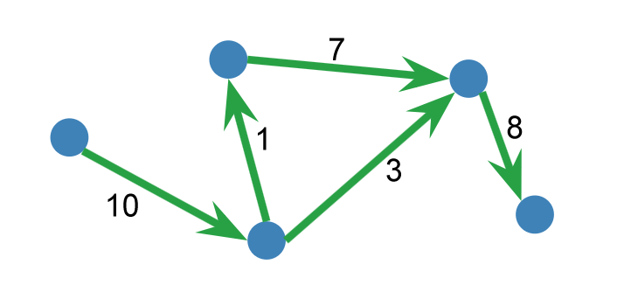
Types of Graphs
Undirected
Directed
Unweighted
Weighted

Slide 54
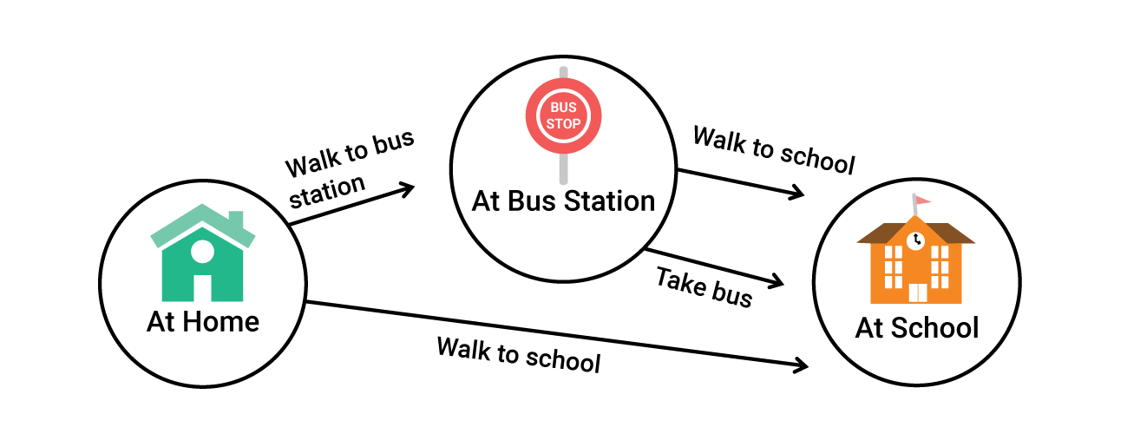
Representing Decisions with Graphs
Important: graphs can also represent decisions
Imagine an algorithm that finds the path to make the best decisions

Slide 55
Some Graph Search Definitions
Traverse: The act of moving across the graph

Slide 56
Some Graph Search Definitions
Traverse: The act of moving across the graph
Source Node: The node that you start from

Slide 57
Some Graph Search Definitions
Traverse: The act of moving across the graph
Source Node: The node that you start from
Target Node: The node that you want to get to

Slide 58
Some Graph Search Definitions
Traverse: The act of moving across the graph
Source Node: The node that you start from
Target Node: The node that you want to get to
Adjacent Nodes: Nodes directly connected by an edge
e.g. B, C, and G are all adjacent to A

Slide 59
Types of Graph Search Algorithms
We will cover three similar graph search algorithms today:
Breadth First Search (BFS)
Dijkstra’s Shortest Path Algorithm
A*
All of these address the pathfinding problem
Many other graph search algorithms exist
But before we talk about these three algorithms, let’s talk about one more concept: data structures

Slide 60
DATA STRUCTURES

Slide 61
Data Structures
A concept used throughout CS that will help us perform our search algorithms

Slide 62
Data Structures
A concept used throughout CS that will help us perform our search algorithms
Data: any sort of information that we can store, like pictures, words, locations, nodes on a graph, objects, etc.

Slide 63
Data Structures
A concept used throughout CS that will help us perform our search algorithms
Data: any sort of information that we can store, like pictures, words, locations, nodes on a graph, objects, etc.
Data Structure: a collection of data that has specific rules for how data is added, accessed, and removed

Slide 64
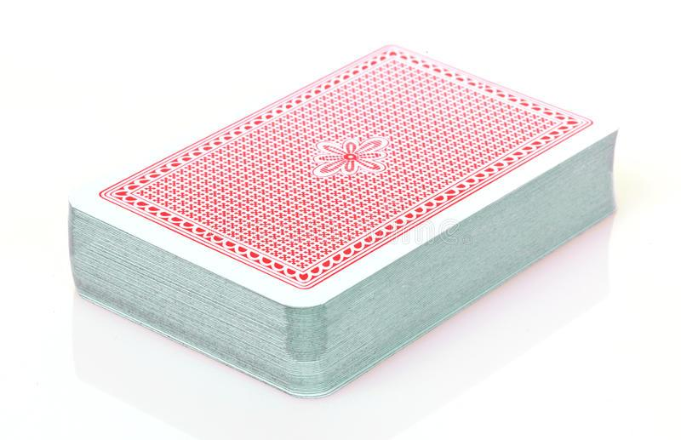
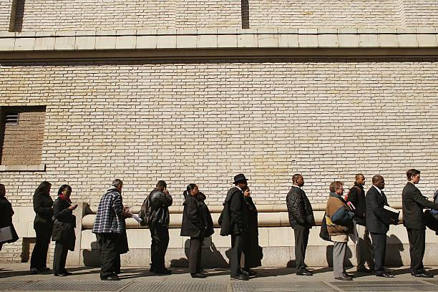
Data Structures
A concept used throughout CS that will help us perform our search algorithms
Data: any sort of information that we can store, like pictures, words, locations, nodes on a graph, objects, etc.
Data Structure: a collection of data that has specific rules for how data is added, accessed, and removed

Slide 65
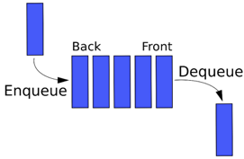
Queue
One particularly common data structure is a queue
Like a line of people:
Enter the queue at the back
Leave the queue at the front
Follows the “first in, first out” (FIFO) convention

Slide 66
Queue Example
Say you push A, C, and B onto the queue in that order. What is at the front of your queue?

Slide 67
Queue Example
Say you push A, C, and B onto the queue in that order. What is at the front of your queue? A

Slide 68
Queue Example
Say you push A, C, and B onto the queue in that order. What is at the front of your queue? A
Now you push D onto the queue. What is at the front of your queue?

Slide 69
Queue Example
Say you push A, C, and B onto the queue in that order. What is at the front of your queue? A
Now you push D onto the queue. What is at the front of your queue? A, still

Slide 70
Queue Example
Say you push A, C, and B onto the queue in that order. What is at the front of your queue? A
Now you push D onto the queue. What is at the front of your queue? A, still
Now you pop from the queue. What element did you pop and what is at the front of the queue now?

Slide 71
Queue Example
Say you push A, C, and B onto the queue in that order. What is at the front of your queue? A
Now you push D onto the queue. What is at the front of your queue? A, still
Now you pop from the queue. What element did you pop and what is at the front of the queue now? Popped A; C is now in front

Slide 72
Queue Example
Say you push A, C, and B onto the queue in that order. What is at the front of your queue? A
Now you push D onto the queue. What is at the front of your queue? A, still
Now you pop from the queue. What element did you pop and what is at the front of the queue now? Popped A; C is now in front
Say you pop everything else from the queue. What order are they popped?

Slide 73
Queue Example
Say you push A, C, and B onto the queue in that order. What is at the front of your queue? A
Now you push D onto the queue. What is at the front of your queue? A, still
Now you pop from the queue. What element did you pop and what is at the front of the queue now? Popped A; C is now in front
Say you pop everything else from the queue. What order are they popped? C, then B, then D

